Slide 1
Objectives
In this session, you will learn to:
  Query data by using subqueries

Slide 2

Using Modified Comparison Operators
The ALL and ANY keywords can be used to modify the existing comparison operators
Notes:
Student already have learnt about type 2 SCDs in Module I. Therefore, you can start this topic by asking the following questions to students:
What are type 2 SCDs?
Given an example to explain type 2 SCDs.
This will recapitulate what they have learnt about type 2 SCD in Module 1.
Now explain the strategy to update the data into these dimension tables with help the example given in SG.
After explaining the examples, you can ask students to think of an example of a type 2 SCD and then tell the strategy to update the data into this dimension table.

Slide 3
Using Modified Comparison Operators (Contd.)
The ALL keyword:
  Returns a TRUE value if all the values that are retrieved by the subquery satisfy the comparison operator.
The ANY keyword:
  Returns a TRUE value, if any value that is retrieved by the subquery satisfies the comparison operator.
Notes:
Student already have learnt about type 2 SCDs in Module I. Therefore, you can start this topic by asking the following questions to students:
What are type 2 SCDs?
Given an example to explain type 2 SCDs.
This will recapitulate what they have learnt about type 2 SCD in Module 1.
Now explain the strategy to update the data into these dimension tables with help the example given in SG.
After explaining the examples, you can ask students to think of an example of a type 2 SCD and then tell the strategy to update the data into this dimension table.

Slide 4
Using Modified Comparison Operators (Contd.)
The following table shows the operators that can be used with the ALL and ANY keywords.
Operator | Description
>ALL | Means greater than the maximum value in the list. The expression | column_name >ALL (10, 20, 30) means ‘greater than 30’
>ANY | Means greater than the minimum value in the list. The expression | column_name >ANY (10, 20, 30) means ‘greater than 10’
=ANY | Means any of the values in the list. It acts in the same way as the IN clause. The expression | column_name =ANY (10, 20, 30) means ‘equal to either 10 or 20 or 30’
<>ANY | Means not equal to any value in the list. The expression | column_name <>ANY (10, 20, 30) means ‘not equal to 10 or 20 or 30’
<>ALL | Means not equal to all the values in the list. It acts in the same way as the NOT IN clause. The expression | column_name <>ALL (10, 20, 30) means ‘not equal to 10 and 20 and 30’
Notes:
Student already have learnt about type 2 SCDs in Module I. Therefore, you can start this topic by asking the following questions to students:
What are type 2 SCDs?
Given an example to explain type 2 SCDs.
This will recapitulate what they have learnt about type 2 SCD in Module 1.
Now explain the strategy to update the data into these dimension tables with help the example given in SG.
After explaining the examples, you can ask students to think of an example of a type 2 SCD and then tell the strategy to update the data into this dimension table.

Slide 5
Using Modified Comparison Operators (Contd.)
The following query displays the employee Id and the title of all the employees whose vacation hours are more than the vacation hours of employees designated as Recruiter:
    SELECT EmployeeID, Title
    FROM HumanResources.Employee
    WHERE VacationHours >ALL (SELECT VacationHours
    FROM HumanResources.Employee WHERE Title
    = 'Recruiter')
Notes:
Student already have learnt about type 2 SCDs in Module I. Therefore, you can start this topic by asking the following questions to students:
What are type 2 SCDs?
Given an example to explain type 2 SCDs.
This will recapitulate what they have learnt about type 2 SCD in Module 1.
Now explain the strategy to update the data into these dimension tables with help the example given in SG.
After explaining the examples, you can ask students to think of an example of a type 2 SCD and then tell the strategy to update the data into this dimension table.

Slide 6
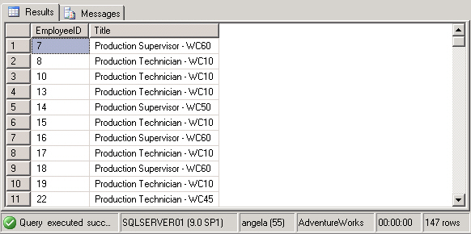
Using Modified Comparison Operators (Contd.)
The following figure displays the output of the preceding query.
Notes:
Student already have learnt about type 2 SCDs in Module I. Therefore, you can start this topic by asking the following questions to students:
What are type 2 SCDs?
Given an example to explain type 2 SCDs.
This will recapitulate what they have learnt about type 2 SCD in Module 1.
Now explain the strategy to update the data into these dimension tables with help the example given in SG.
After explaining the examples, you can ask students to think of an example of a type 2 SCD and then tell the strategy to update the data into this dimension table.

Slide 7
Just a minute
What is the use of the EXISTS keyword in a subquery?
Solution:
  The EXISTS keyword is used to check the existence of rows in the result set of an inner query according to the condition specified in the inner query.
Notes:
Student already have learnt about type 2 SCDs in Module I. Therefore, you can start this topic by asking the following questions to students:
What are type 2 SCDs?
Given an example to explain type 2 SCDs.
This will recapitulate what they have learnt about type 2 SCD in Module 1.
Now explain the strategy to update the data into these dimension tables with help the example given in SG.
After explaining the examples, you can ask students to think of an example of a type 2 SCD and then tell the strategy to update the data into this dimension table.

Slide 8
Using Aggregate Functions
Aggregate functions:
  Can be used to generate aggregate values from the inner query.
  For example:
    SELECT EmployeeId FROM HumanResources.Employee
    WHERE VacationHours >(SELECT AVG(VacationHours) FROM HumanResources.Employee
    WHERE Title = 'Marketing Assistant')
Notes:
Student already have learnt about type 2 SCDs in Module I. Therefore, you can start this topic by asking the following questions to students:
What are type 2 SCDs?
Given an example to explain type 2 SCDs.
This will recapitulate what they have learnt about type 2 SCD in Module 1.
Now explain the strategy to update the data into these dimension tables with help the example given in SG.
After explaining the examples, you can ask students to think of an example of a type 2 SCD and then tell the strategy to update the data into this dimension table.

Slide 9
Using Aggregate Functions (Contd.)
Aggregate functions:
  Can be used to generate aggregate values from the inner query.
  For example:
    SELECT EmployeeId FROM HumanResources.Employee
    WHERE VacationHours >(SELECT AVG(VacationHours) FROM HumanResources.Employee
    WHERE Title = 'Marketing Assistant')
The inner query returns the average vacation hours of all the employees who are titled as Marketing Assistant.
Notes:
Student already have learnt about type 2 SCDs in Module I. Therefore, you can start this topic by asking the following questions to students:
What are type 2 SCDs?
Given an example to explain type 2 SCDs.
This will recapitulate what they have learnt about type 2 SCD in Module 1.
Now explain the strategy to update the data into these dimension tables with help the example given in SG.
After explaining the examples, you can ask students to think of an example of a type 2 SCD and then tell the strategy to update the data into this dimension table.

Slide 10
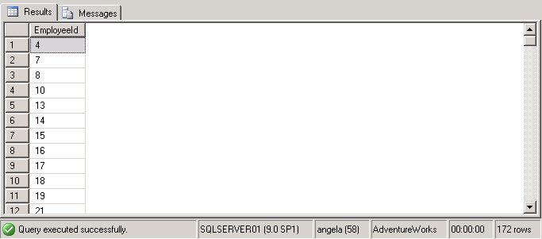
Using Aggregate Functions (Contd.)
  The following figure displays the output of the preceding query.
Notes:
Student already have learnt about type 2 SCDs in Module I. Therefore, you can start this topic by asking the following questions to students:
What are type 2 SCDs?
Given an example to explain type 2 SCDs.
This will recapitulate what they have learnt about type 2 SCD in Module 1.
Now explain the strategy to update the data into these dimension tables with help the example given in SG.
After explaining the examples, you can ask students to think of an example of a type 2 SCD and then tell the strategy to update the data into this dimension table.

Slide 11
Using Nested Subqueries
Nested subqueries:
  Contain one or more subqueries.
  Can be used when the condition of a query is dependent on the result of another query.
  For example:
    SELECT DepartmentID FROM HumanResources.EmployeeDepartmentHistory
    WHERE EmployeeID =
    (SELECT EmployeeID FROM HumanResources.Employee
    WHERE ContactID =
    (SELECT ContactID FROM Person.Contact WHERE EmailAddress = 'taylor0@adventure-works.com')
    )
Notes:
Student already have learnt about type 2 SCDs in Module I. Therefore, you can start this topic by asking the following questions to students:
What are type 2 SCDs?
Given an example to explain type 2 SCDs.
This will recapitulate what they have learnt about type 2 SCD in Module 1.
Now explain the strategy to update the data into these dimension tables with help the example given in SG.
After explaining the examples, you can ask students to think of an example of a type 2 SCD and then tell the strategy to update the data into this dimension table.

Slide 12
Using Nested Subqueries (Contd.)
Nested subqueries:
  Contain one or more subqueries.
  Can be used when the condition of a query is dependent on the result of another query.
  For example:
    SELECT DepartmentID FROM HumanResources.EmployeeDepartmentHistory
    WHERE EmployeeID =
    (SELECT EmployeeID FROM HumanResources.Employee
    WHERE ContactID =
    (SELECT ContactID FROM Person.Contact WHERE EmailAddress = 'taylor0@adventure-works.com')
    )
The level 2 inner query returns the contact Id of an employee based on the e-mail address of the employee from the Person table.
Notes:
Student already have learnt about type 2 SCDs in Module I. Therefore, you can start this topic by asking the following questions to students:
What are type 2 SCDs?
Given an example to explain type 2 SCDs.
This will recapitulate what they have learnt about type 2 SCD in Module 1.
Now explain the strategy to update the data into these dimension tables with help the example given in SG.
After explaining the examples, you can ask students to think of an example of a type 2 SCD and then tell the strategy to update the data into this dimension table.

Slide 13
Using Nested Subqueries (Contd.)
Nested subqueries:
  Contain one or more subqueries
  Can be used when the condition of a query is dependent on the result of another query
  For example:
    SELECT DepartmentID FROM HumanResources.EmployeeDepartmentHistory
    WHERE EmployeeID =
    (SELECT EmployeeID FROM HumanResources.Employee
    WHERE ContactID =
    (SELECT ContactID FROM Person.Contact WHERE EmailAddress = 'taylor0@adventure-works.com')
    )
The level 1 inner query uses this contact Id to search for the employee Id of the employee with the given e-mail address.
Notes:
Student already have learnt about type 2 SCDs in Module I. Therefore, you can start this topic by asking the following questions to students:
What are type 2 SCDs?
Given an example to explain type 2 SCDs.
This will recapitulate what they have learnt about type 2 SCD in Module 1.
Now explain the strategy to update the data into these dimension tables with help the example given in SG.
After explaining the examples, you can ask students to think of an example of a type 2 SCD and then tell the strategy to update the data into this dimension table.

Slide 14
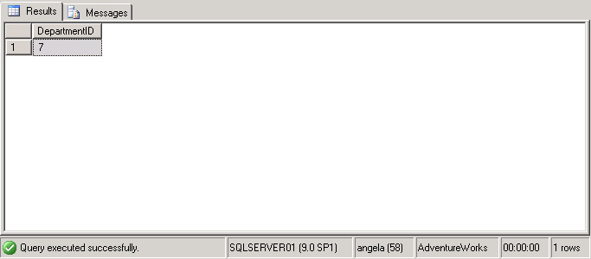
Using Nested Subqueries (Contd.)
  The following figure displays the output of the preceding query.
Notes:
Student already have learnt about type 2 SCDs in Module I. Therefore, you can start this topic by asking the following questions to students:
What are type 2 SCDs?
Given an example to explain type 2 SCDs.
This will recapitulate what they have learnt about type 2 SCD in Module 1.
Now explain the strategy to update the data into these dimension tables with help the example given in SG.
After explaining the examples, you can ask students to think of an example of a type 2 SCD and then tell the strategy to update the data into this dimension table.

Slide 15
Using Correlated Subqueries
Correlated subqueries:
  Can be defined as a query that depends on the outer query for its evaluation.
  Uses the WHERE clause to refer to the table specified in the FROM clause.
  For example:
    SELECT * FROM EmployeeDetails e
    WHERE Salary = (SELECT max(Salary) FROM EmployeeDetails WHERE DeptNo = e.DeptNo)
Notes:
You can summarize the session by running through the summary given in SG.
In addition, you can also ask students summarize what they have learnt in this session.

Slide 16
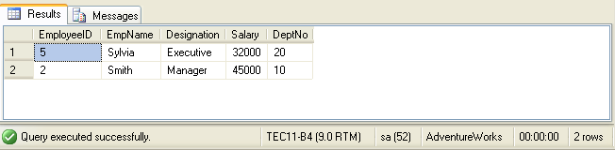
Using Correlated Subqueries (Contd.)
  The preceding query will display the employees who earn the highest salary in their department, as shown in the following figure.
Notes:
You can summarize the session by running through the summary given in SG.
In addition, you can also ask students summarize what they have learnt in this session.

Slide 17
Just a minute
Write a query to determine the employee Id and the department Id of all the employees whose manager Id is 12 from the AdventureWorks database.
Solution:
  SELECT EmployeeID, DepartmentID FROM HumanResources.EmployeeDepartmentHistory WHERE EmployeeID=(SELECT EmployeeID FROM HumanResources.Employee WHERE ManagerID=12)
Notes:
Student already have learnt about type 2 SCDs in Module I. Therefore, you can start this topic by asking the following questions to students:
What are type 2 SCDs?
Given an example to explain type 2 SCDs.
This will recapitulate what they have learnt about type 2 SCD in Module 1.
Now explain the strategy to update the data into these dimension tables with help the example given in SG.
After explaining the examples, you can ask students to think of an example of a type 2 SCD and then tell the strategy to update the data into this dimension table.

Slide 18
Demo: Using Subqueries
Problem Statement:
  The management of AdventureWorks, Inc. is planning to revise the pay rate of the employees. For this, they want a report containing the EmployeeID and designation of those employees whose present pay rate is more than $40.
  How will you generate this report?
Notes:
You can summarize the session by running through the summary given in SG.
In addition, you can also ask students summarize what they have learnt in this session.

Slide 19
Demo: Using Subqueries (Contd.)
Solution:
  To solve the preceding problem, you need to perform the following tasks:
    Create a query.
    Execute the query to verify the result.
Notes:
You can summarize the session by running through the summary given in SG.
In addition, you can also ask students summarize what they have learnt in this session.

Slide 20
Summary
In this session, you learned that:
  The ALL and ANY keyword is used in a subquery to modify the existing comparison operator.
  Aggregate functions can also be used in subqueries to generate aggregated values from the inner query.
  Subqueries that contain one or more queries are specified as nested subqueries.
  A correlated subquery can be defined as a query that depends on the outer query for its evaluation.
Notes:
You can summarize the session by running through the summary given in SG.
In addition, you can also ask students summarize what they have learnt in this session.

